Slide 1
KJJ Auto
Database Application
Group 3
By: Jeremy Randolph, Justin Koo, and Kelly Moore

Slide 2
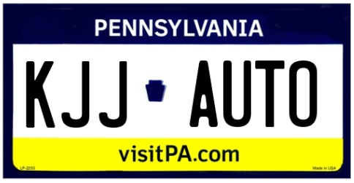
Summary:
KJJ Auto was designed with the intention of simplifying the car buying experience. Our team set out to develop an all in one platform for users to research any car they are interested in buying. No longer will users have to scour local listings or dealership websites. KJJ Auto is looking to reinvent the car buying experience.

Slide 3
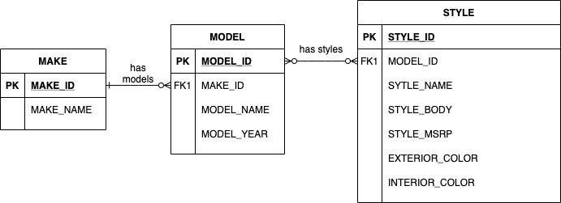
Under the Hood

Slide 4
Rules of the Road
Master Table of the brands
Primary key for each of the brands
One brand can have many different cars but cars belong to only one brand
Sub tables for each brand consisting of the current model line up and year of the model
Unique primary key for each model
Foreign key for the brand of the car
Style table for each model. Every year, models of cars change in some way whether its style, body type, or MSRP
Primary Key for each style
Foreign key for the model of car
A model can have many styles, but each style belongs to only one mode

Slide 5
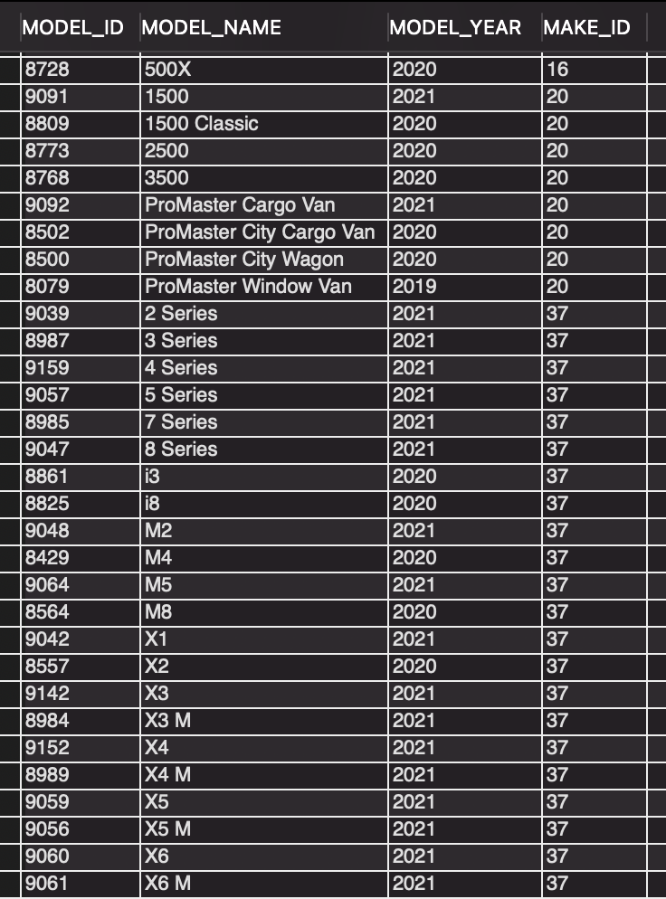
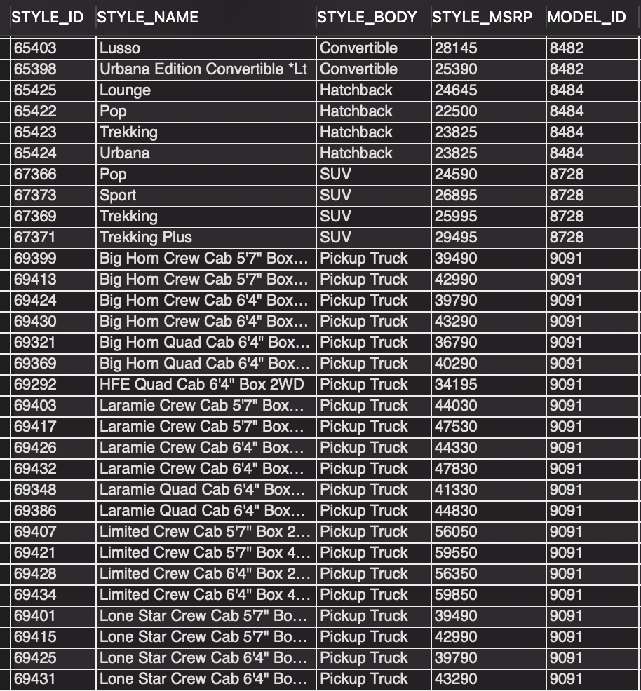
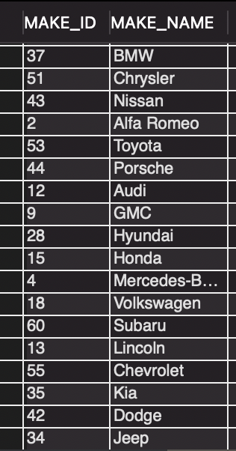
Make, Models, and Styles:
Models:
Styles:
Make:

Slide 6
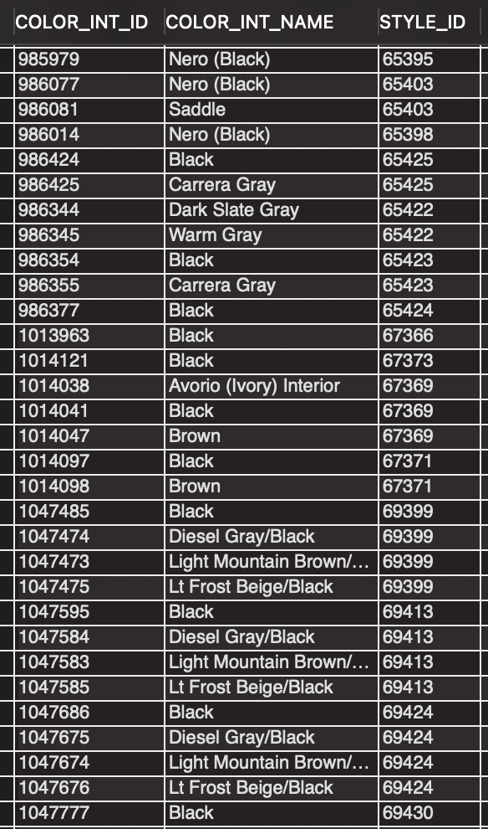
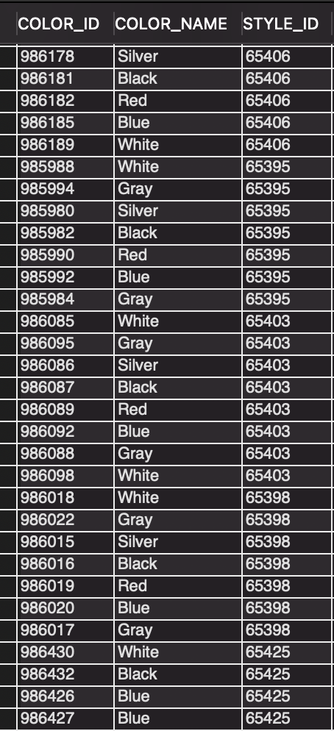
Color Options
Interior Colors:
Exterior Colors:

Slide 7
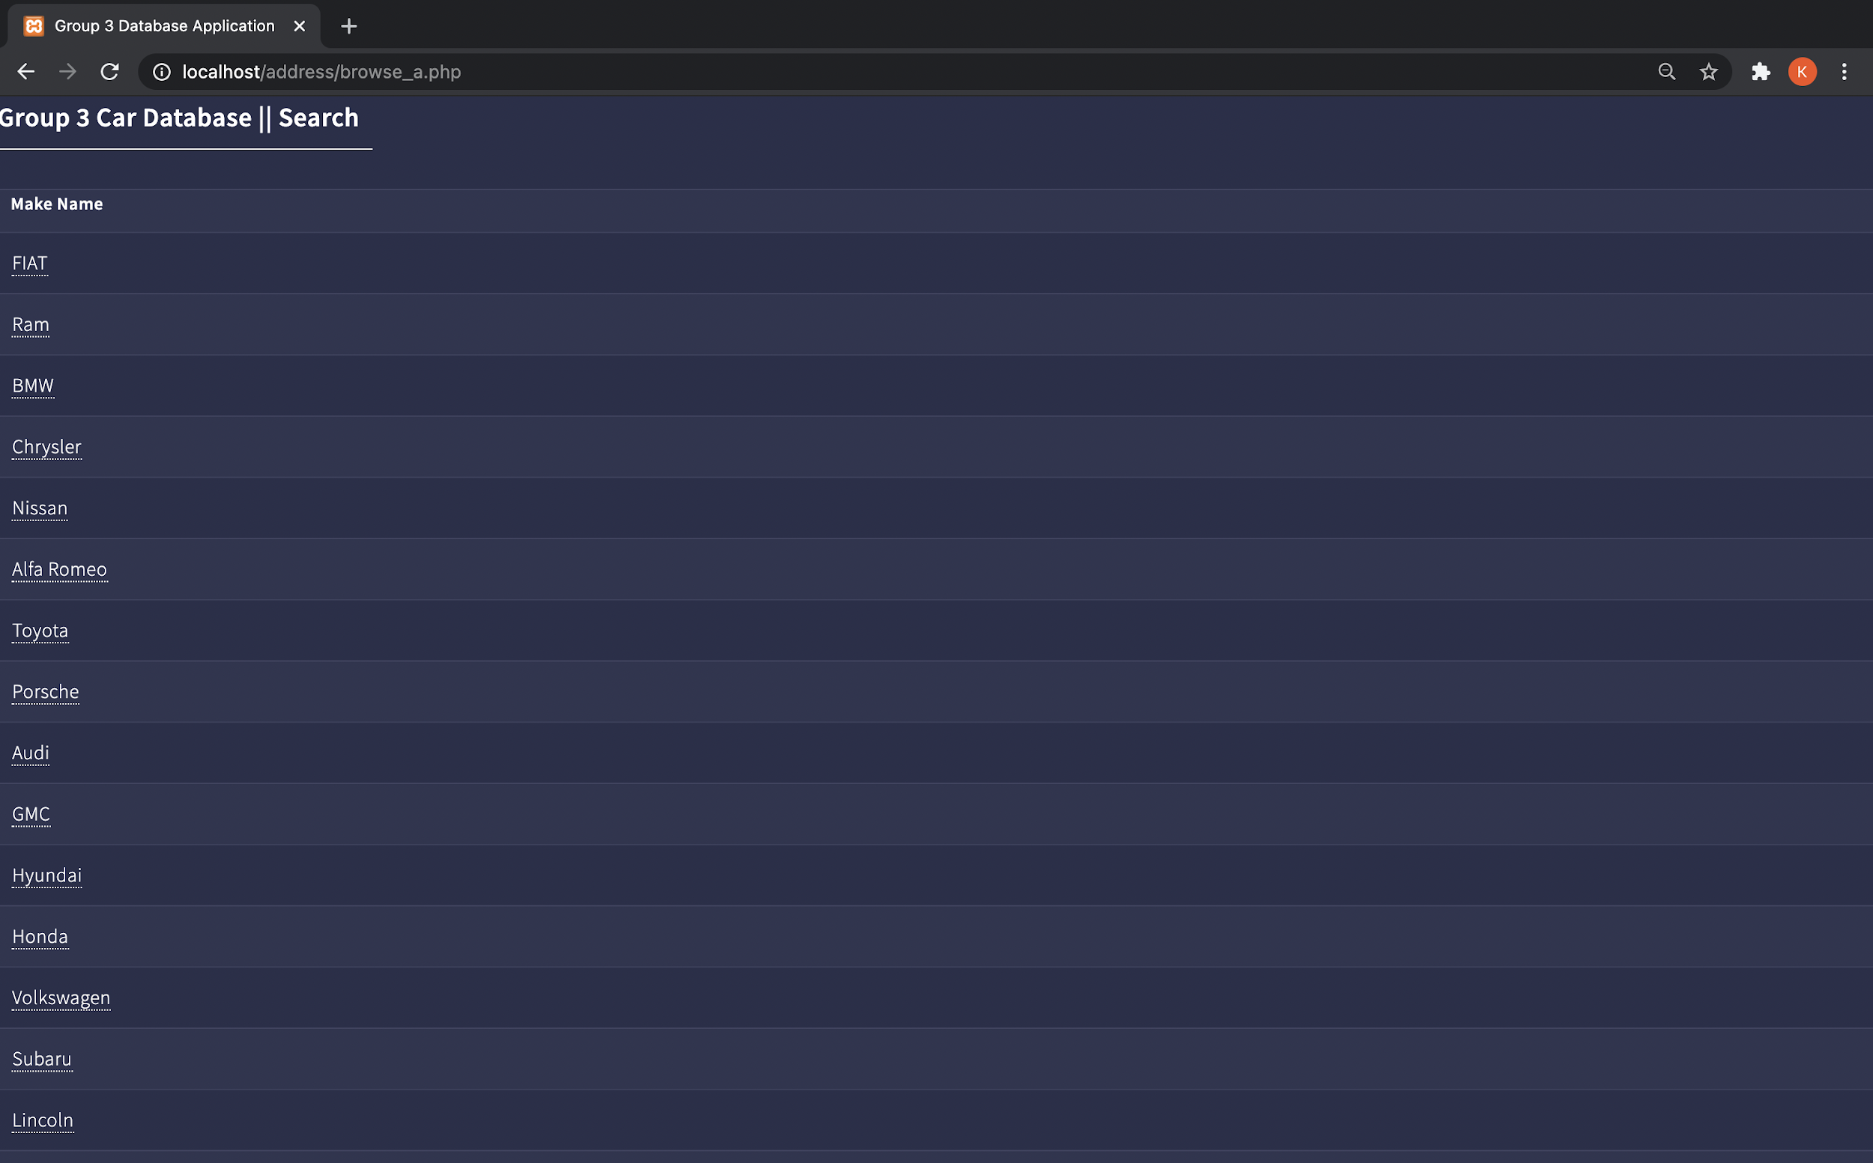
Main Page

Slide 8
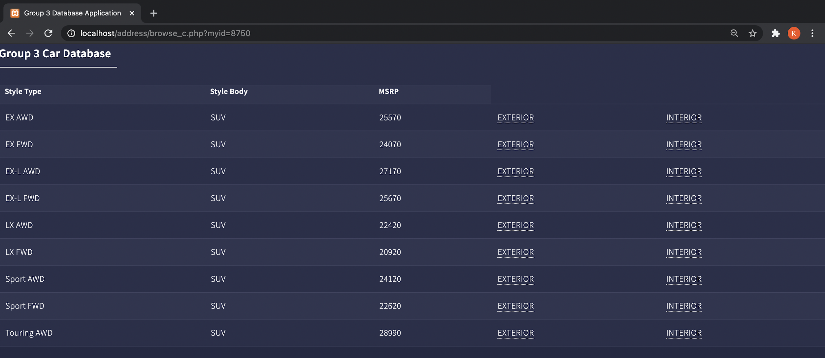
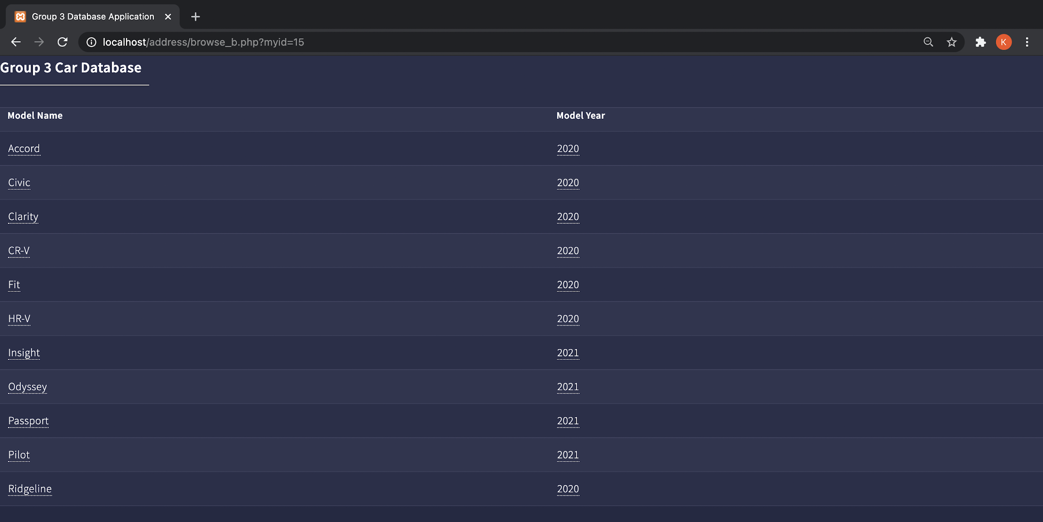
User Interface - Browse
If user selects “HR-V”, the following screen will appear.
If user selects “Honda”, then the following screen will appear.

Slide 9
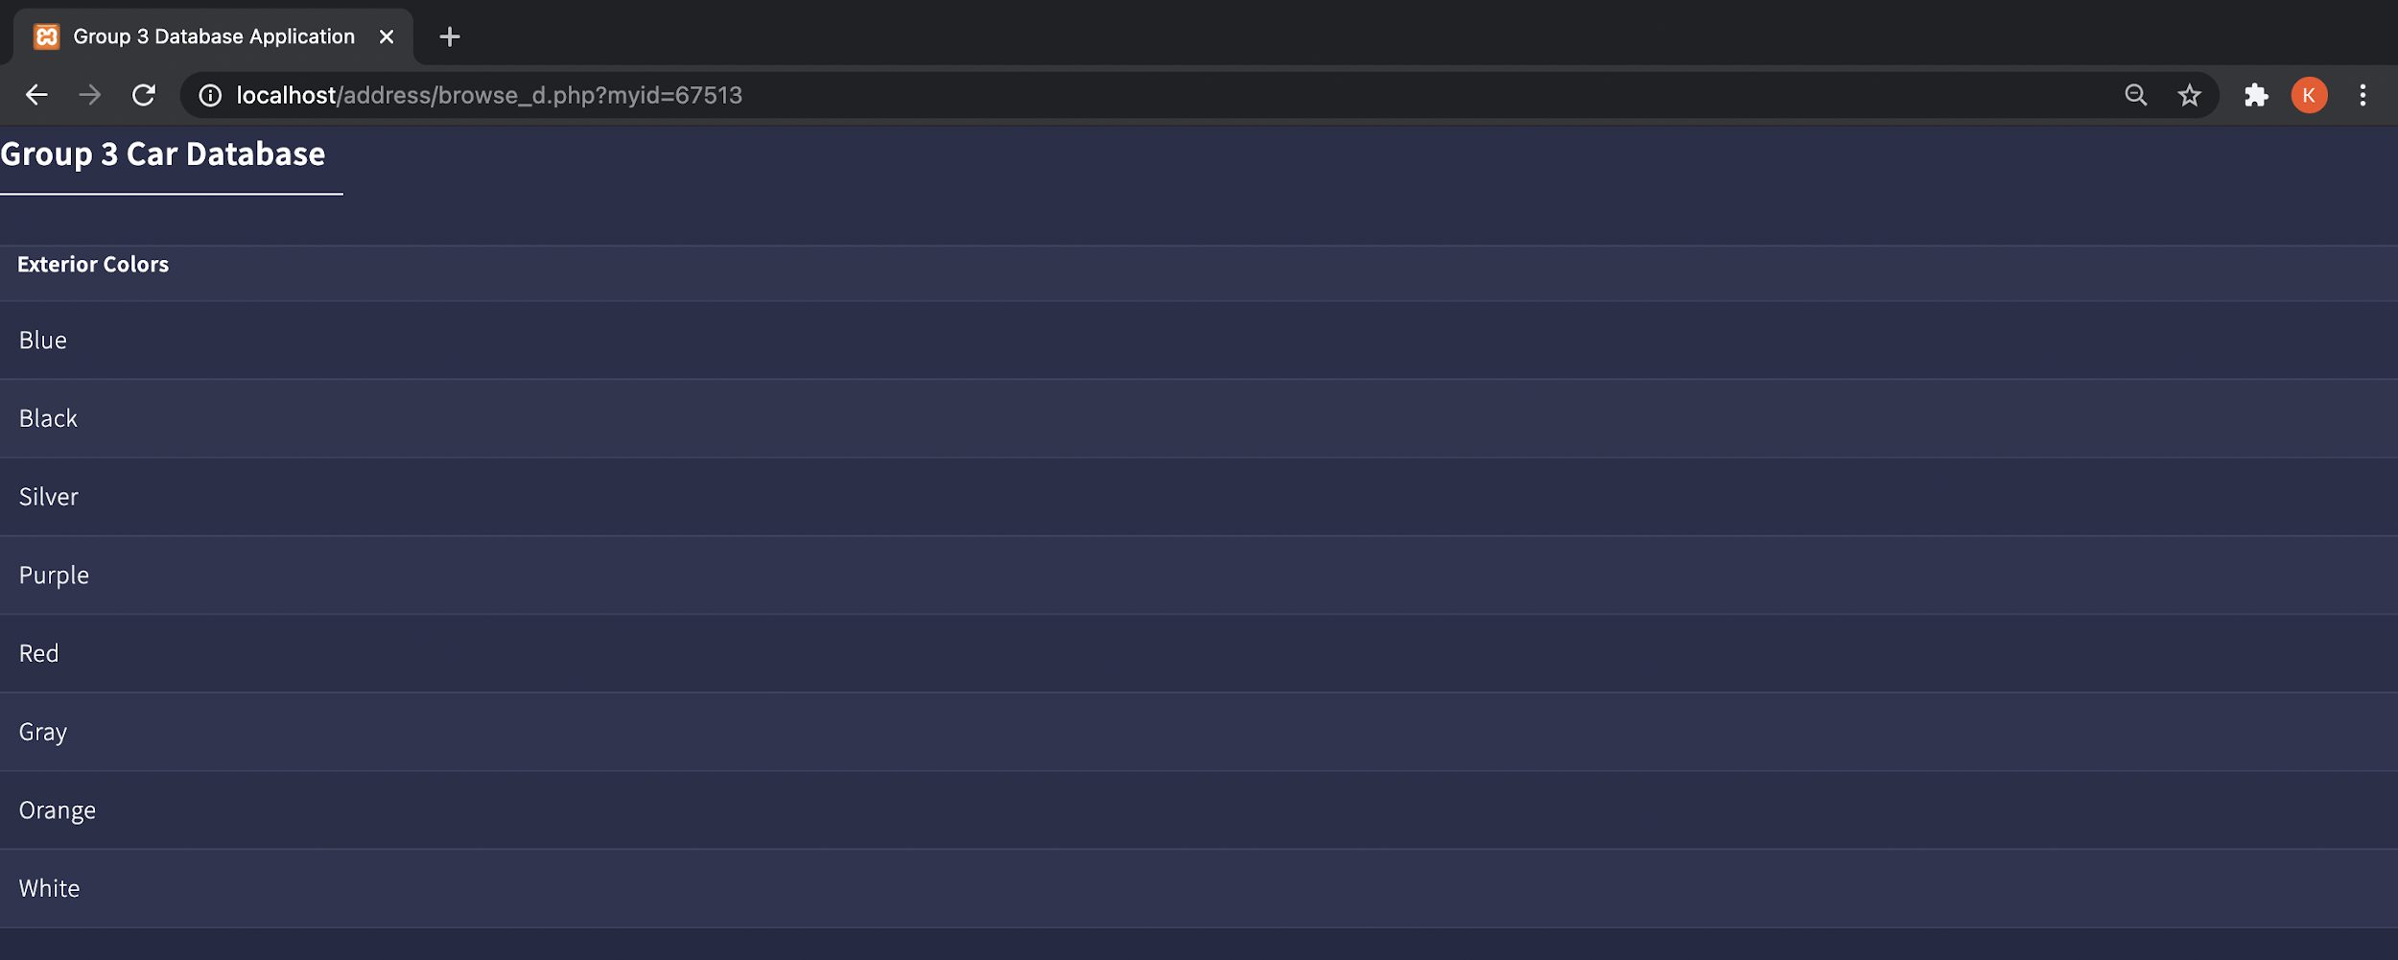
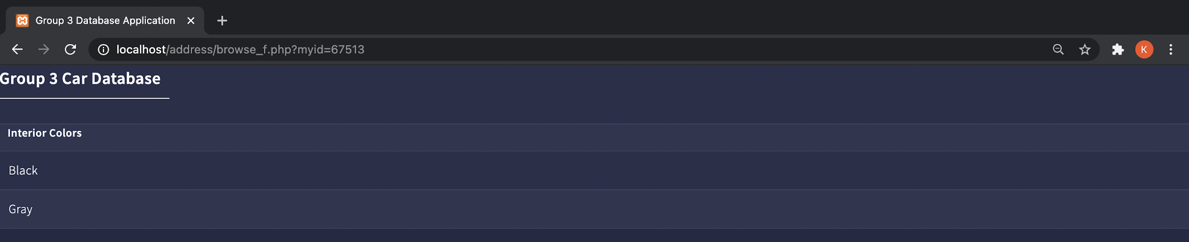
User Interface - Browse Cont.
If the user goes back and selects “Interior Colors” on Touring AWD instead, the following screen will appear.
If the user selects “Exterior” for Touring AWD, then the following screen will appear.

Slide 10
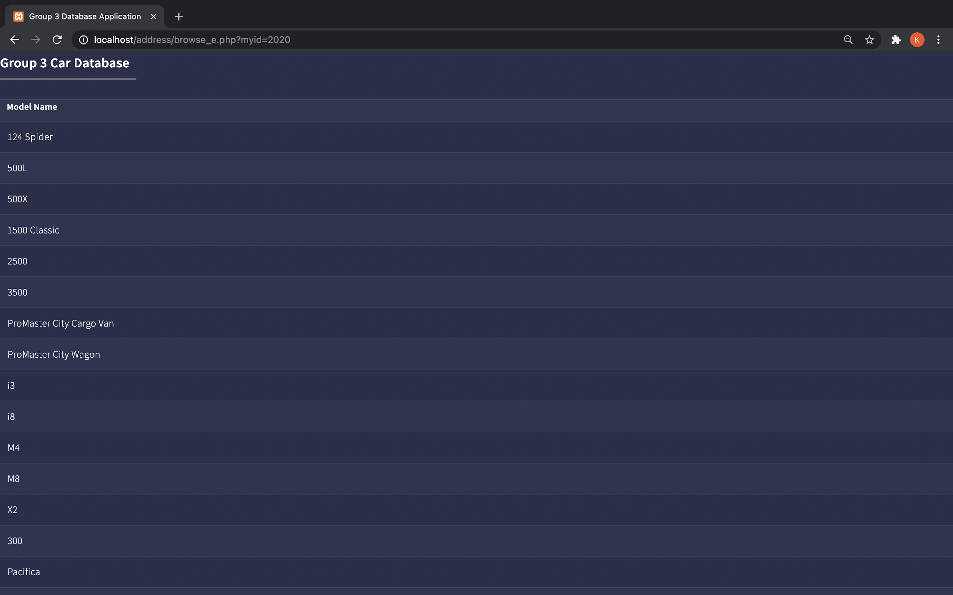
User Interface - Browse Cont.
If the user goes back to the second screen and selects “2020” on any of the options, the following screen will appear (only showing the first page of results).

Slide 11
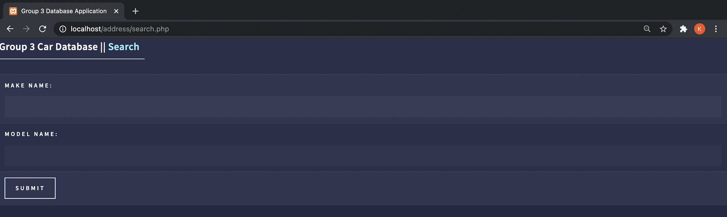
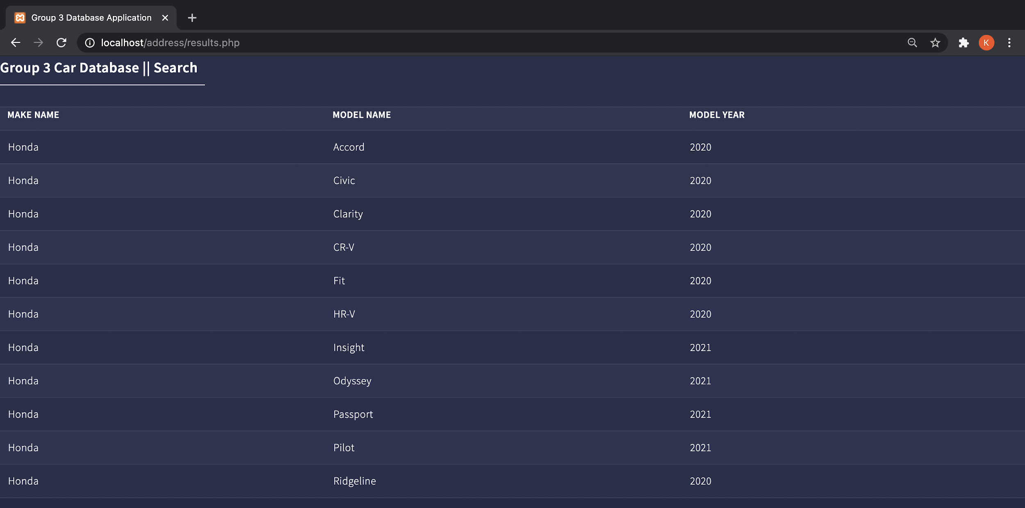
User Interface - Search
If the user searches for “Honda” in the make name field, the following screen will appear

Slide 12
Challenges and Takeaways
Connecting local MySQL workbench to AWS services
Loading the data into our database system
Creating an application to display our data
How to set up an end to end system for a project
Mass loading data into a database
Handling a ransomware attack

Slide 13
Thank you

